Slide 1
Designing an a Mobile App
EduTek App for a children for learning alphabet

Slide 2
STEP 1
User requirements and intended purpose
Before we start

Slide 3
User requirements and intended purpose
Since the application is for children, it should be intuitive, because young children do not know much, and do not yet know how to learn about something correctly. Therefore, we will still expect that someone from parents, teachers, etc. will explain to the child how to use the application.
What user requirements are we counting on:
Cross-platform application(Android/IOS/PC WEB)
Adaptive & simple design for all platforms
Simple app navigation via buttons, swipes, taps
The possibility of testing aka knowledge verification
Demonstration of the material in the form of something to make it easier to understand a letter, or a word
Offline mode
Game coloured mode
Pronunciation learning and practice
Intended purpose - to give users (mainly children, because they our target audience 3+ years old) the opportunity to learn the alphabet of a certain language (it can be both their native language and some other), using simple methods, possibly in a game way, and the opportunity to test their knowledge in alphabet just like what EduTek wants.
But accessibility is a chunk confined to those who are not absolutely blind due to the fact you can’t convert a number of the content material at the screen, such as visible photos into speech or braille. It can be properly for those who are partly sighted for the reason that app placed the colours in properly use.
Notes:
Before we start developing an application or a design for it - we need to research
and work out all the points of our application, and follow certain requirements for
the design of the application, since the target audience is children.
Since the application is for children, it should be intuitive,
because young children do not know much, and do not yet know
how to learn about something correctly.
Therefore, we will still expect that someone from parents, teachers, etc. will explain to the child how to use the application.
He can figure it out through hints and tutorial screens with tips when installing the app for the first time,
or use the scientific touch method, since the app will be minimalistic and intuitive,
and with features designed to make the app easier to use.
What user requirements are we counting on:
Cross-platform application(Android/IOS/PC WEB) – because many users have only iPhone, or any Android device, or only a PC, so we need make useful tool for all of these platforms.
Adaptive & simple design for all platforms – someone have a small phone, someone have big tablet or big screen of PC so design must be adaptive.
Simple app navigation via buttons, swipes, taps – we don’t need make nothing new, because mostly all users know about these gestures
The possibility of testing aka knowledge verification – After some in-app lessons users need check his
Demonstration of the material in the form of something to make it easier to understand a letter, a word. For example, most alphabets for children have some animals or objects from everyday life that the child already knows, and you can easily guess where this letter is used
Offline mode – people don’t have internet connection or good internet everywhere and every time so offline mode is a good solution
Game mode – kids can pay attention by light colours, sounds and while something in move
Pronunciation learning and practice
Intended purpose - to give users (mainly children) the opportunity to learn the alphabet of a certain language (it can be both their native language and some other), using simple methods, possibly in a game way, and the opportunity to test their knowledge in alphabet just like what EduTek wants.
But accessibility is a chunk confined to those who are absolutely blind due to the fact you can’t convert a number of the content material at the screen, such as visible photos into speech or braille. It can be properly for those who are partly sighted for the reason that app placed the colours in properly use.

Slide 4
Main program solution
The app will be developed on Flutter&Dart, because it's a pretty new and cool technology, it allows you to develop good cross-platform apps in a short period of time without any extra stuff. Currently, there are many ready-made applications for IOS and Android, as well as websites and standalone applications for computers, and there are also a large number of additional modules developed by Google and the community, they exist for a variety of purposes, for example, it can be working with a camera, or automatic positioning of the element on the screen, display of the list in objects.
That's why we'll be using it, and we'll be using all the iOS guidelines and tips for designing and prototyping.
The program does not need heavy functionality, this shows that we do not need an additional backend for the normal functioning of the application, except that we can add OAuth2 support so that the user can save the result and synchronise the progress with the cloud at the right time.
All core design and layout will be built on auto generators to optimise code and reduce duplication.
The main functionality will be quite simple, this is a list of the main functions that will be used when working with the application:
OAuth2 authorisation via Apple or Google
OAuth2 backup and restoring data
Tap handlers for grabbing users gestures
Pop-up windows for making a mistake or a success notification
Make GridLayout via Expanded/Column/Row/SingleChildScrollView with button gestures support
Quiz generator
Build Letter page with images/sounds/additional text from a json file

Slide 5
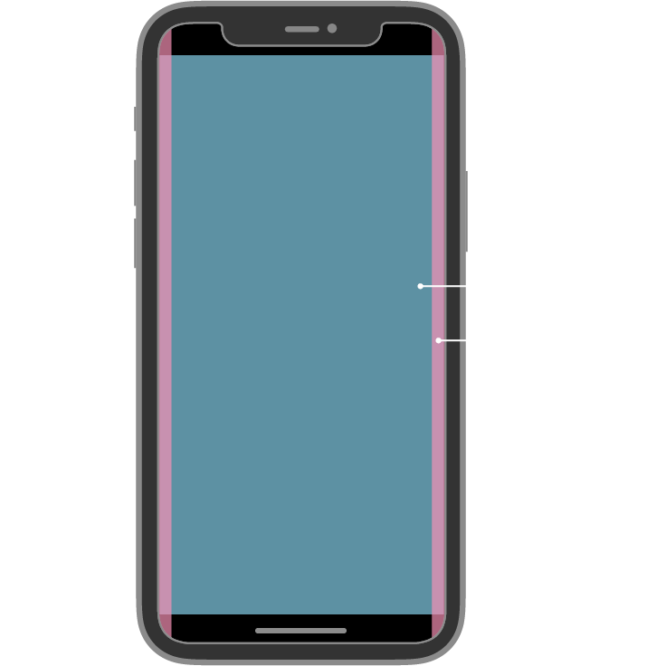
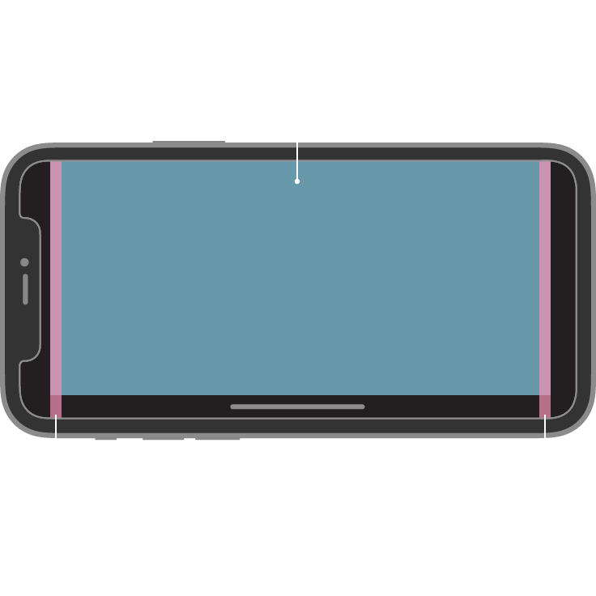
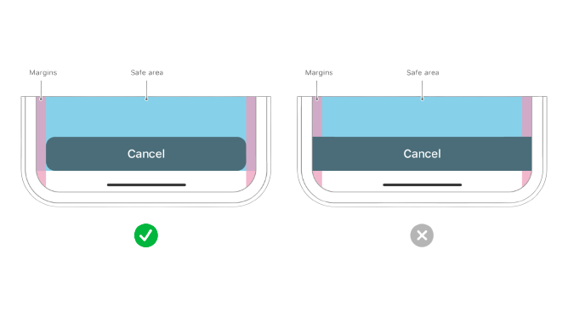
Design specification
IOS Safe Areas
Due to the fact that the main target audience is children - we need to make a very minimalistic design to improve the user experience of using the application. That is, to use simple minimalist layouts and the location of buttons in them
To do this, we have a great screenshot on the left of the main safe areas for serving your content to the user.
This is one of the main principles of the IOS guideline that we will follow.
Unfortunately or fortunately, we will not be able to use a strict professional design, because young children are very active and they are attracted to something brightly coloured and moving.
So the basic design will be a gradient or static background of one colour, and midtones of blue, red, black, and orange.
In the very process of learning the letter - the user will have a picture, the name of this letter, its written form, a button to play the pronunciation of the letter, words where it is used and a slideshow with things where the letter is used, and their pronunciation
Navigation between pages will be work by basic gestures(swipes) and buttons(tapping on them)
The main layout will be make adaptive for portrait and landscape mode with different sizes

Slide 6
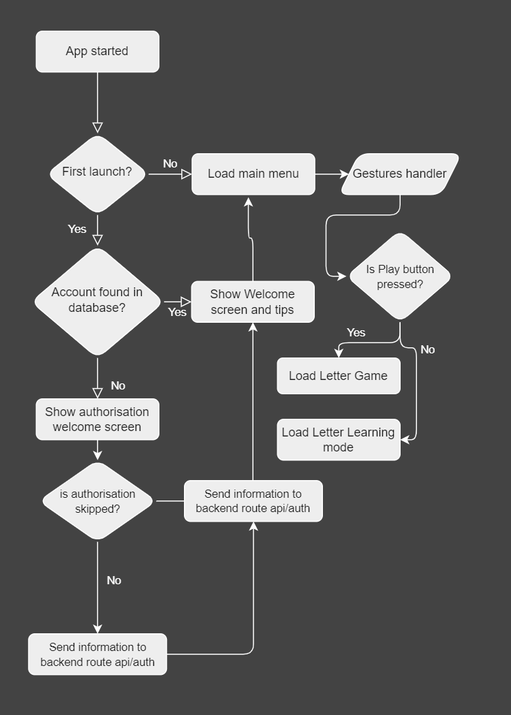
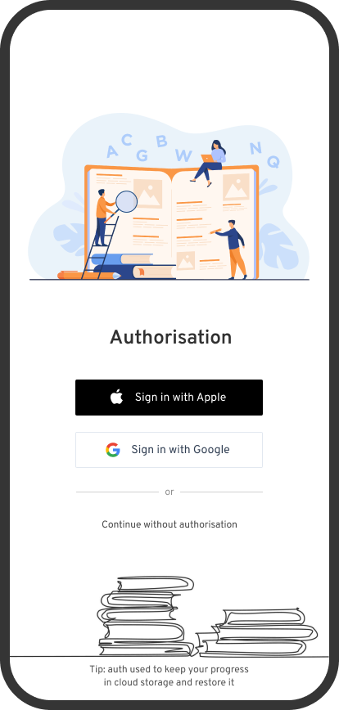
Application prototype
Start-up Flowchart
Authorisation Screen
On a right side of slide you can see “Start-up flowchart” with basic algorithm for new users. During the fact that users don’t know how to use our app after start – we need automate some stuff like checking if that’s first app start, or a second one. After check if we need to show a welcome screen with authorisation or a load man menu.
So basically it’s pretty simple algorithm but enough for our Authorisation screen solution
As you can see we will have a OAuth support, because mostly users have a Apple or a Google accounts, but if not – they can continue without authorisation and saving their progress

Slide 7
Application Assets
File Name | Description | Source
Overpass-Regular.ttf | Font-file with regular weight of font | GoogleFonts
Overpass-SemiBold.ttf | Font-file with bold weight of font | GoogleFonts
Apple.png | Illustration for A letter | Figma
Ball.png | Illustration for B letter | Figma
Bicycle_unit1.png | Illustration for unit 1 section | Figma
Book_unit1.png | Illustration for unit 1 section | Figma
Books.png | Illustration of learning and books for auth screen | Figma
Car.png | Illustration for C letter | Figma
Crown.png | Illustration for marking crowns aka score progress | Figma
Icecream.png | Illustration for I letter | Figma
Queen.png | Illustration for Q letter | Figma
Learn,png | Illustration of learning and books for auth screen | Figma
Lampa.png | Illustration for L letter | Figma

Slide 8
Application Test Plan
N | Description | Input | Action | Expected Result | Actual Result
1 | Test Authorisation on main screen | OAuth, Gestures | Press auth button | User profile will be loaded via oauth services | Authorisation work and temporary disabled while testing.
2 | Test Offline Authorisation | Gestures, SharedPref | Press offline btn | User profile will be saved in SharedPrefs | User profile successfully saved to SharedPrefs
3 | Test Audio | Gestures | Press letter pronounce btn | Audio will be played | Audio has been played
4 | Test Help Page | Gestures | Press help btn | Popup Help AlertPage | Help page popped up
5 | Test Game Page | Gestures, Microphone | Press “Learn” button on screen | Start learning letters game | Game has been loaded
6 | Test Close AlertPages btn and swipes | Gestures | Swipe or press button on Page | Popped Page will be closed | Swipes and buttons work fine
7 | Test result of game | Score, Mistakes | Finish Knowledge test | Show score and analyse mistakes | Result has been displayed via pop-up and snackbar

Slide 9
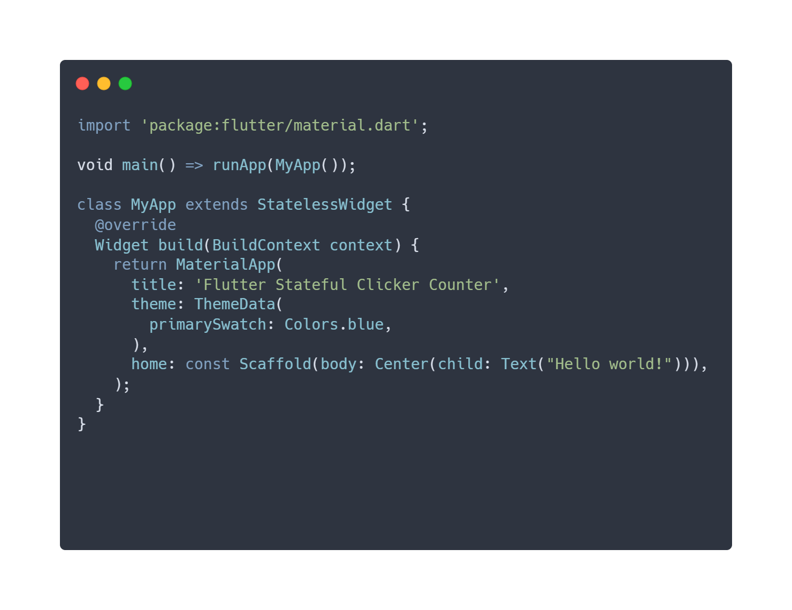
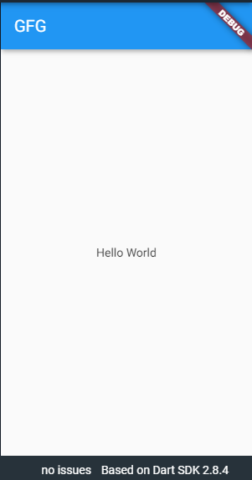
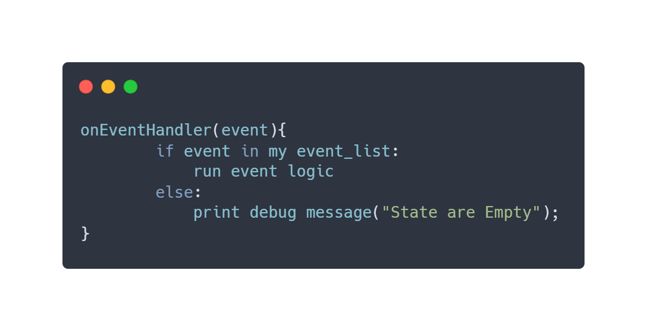
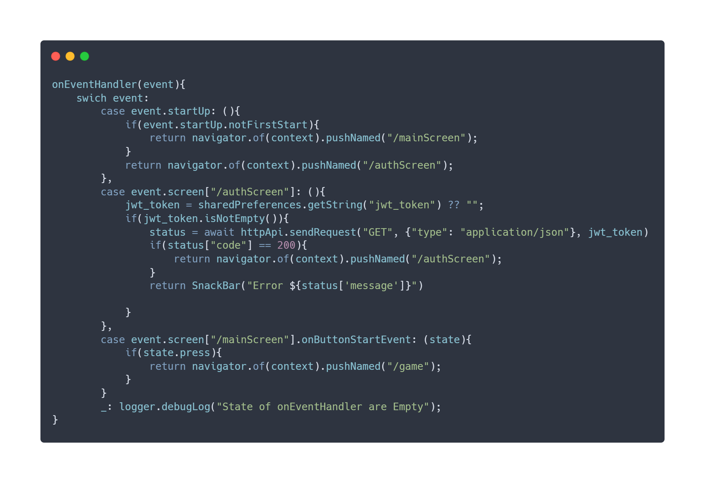
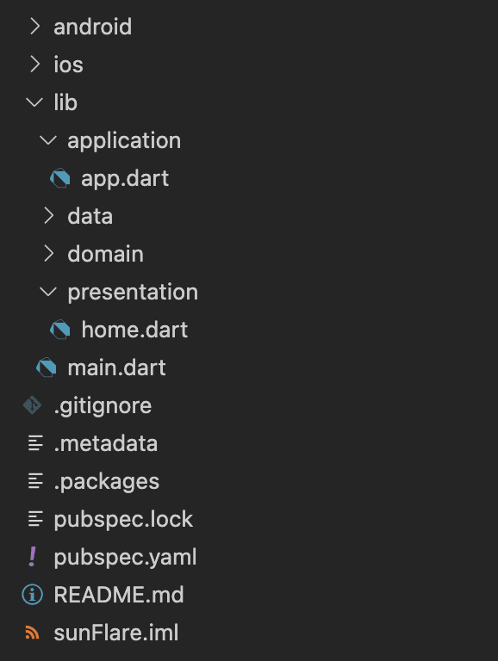
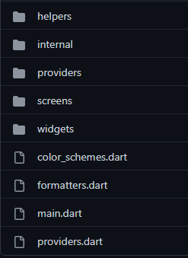
Pseudo Code
Snippets of Code and Architecture
As you can see below we have a base EventLoopHandler named “onEventHandler”. His main task – control app state and look up on new events, if something get in his event list – he will start anonymous function included in switch-case system. This is a small part of all algorithm but enough to understand how event-system will work.
We also can create multiple subscribers via Provider or BLoC/RiverPod and control our states/events.
Basic Flutter Hello World Application
Flutter “Clean“ Architecture Example

Slide 10
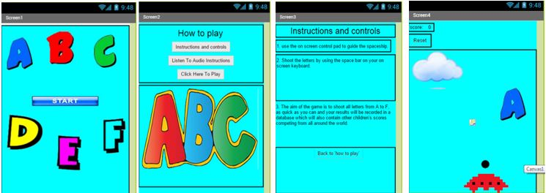
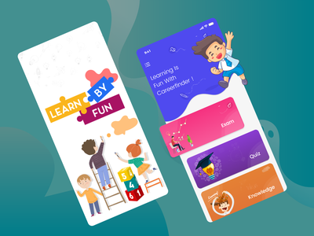
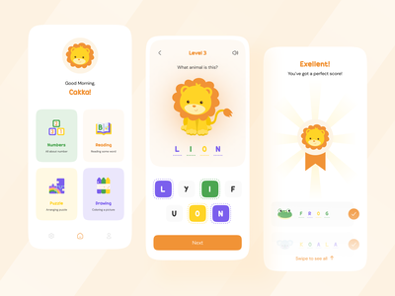
Alternative Design
Alt. Design Example
Type’s of design on left side of the screen – may exist, but they are very difficult in UI/UX areas.
Why?
Too much different colours, hard to recognise which button are located
Letters on SplashScreen and MainScreen attract too much attention
Instructions made on Table-Like technics, which are too old and don’t usable for new Design-Systems
Background colour too light, that’s bad colour-palette practice, because we have to follow PlatformDesignGuideLines, where written that we have use darker BGColour than our accent colour
Game have a bad UI, because again Table-Like design
Mixed Design of letters, even in game – our StarShip in a Pixel-style, when letter’s in Draw-Comic style, Clouds in a Vector-Illustration gradient style, that’s all on solid background with big black lines as table borders.
As you can see this is pretty hard design for kids, even for adult’s
Good UI/UX Design alternative

Slide 11
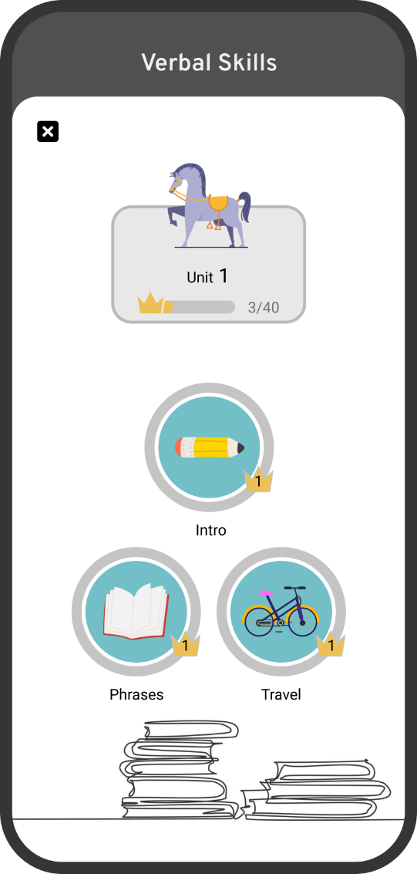
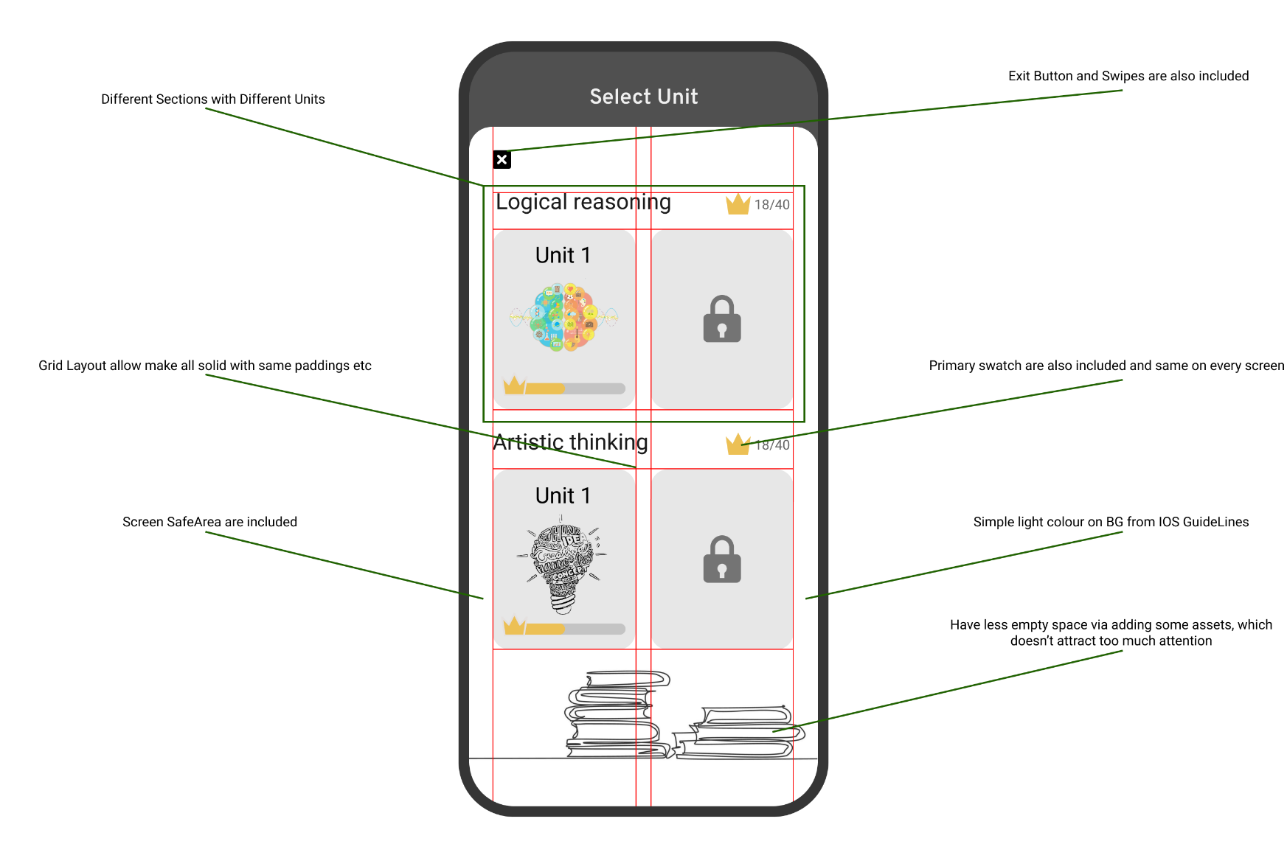
Why our Design
Design Example
Clear and Easy to understand/navigate design
Simple, Fast, Easy to navigate, made with platform Guidelines that what’s we need

Slide 12
Design Decisions
We know our user requirements, so how we fulfil them?
We use Flutter&Dart technologies which allow fulfil cross platform and adaptive design for all platform because all people have devices on different platforms, different form-factor, and our app have to be same on all devices. F&D can provide this.
Simple app navigation via buttons, swipes, taps and design we fulfil by following IOS/Material Design Guidelines as app for small kids, they don’t have experience of using mobile apps, so everything should be simple.
App include game-mode which allow possibility of practice knowledge, learn pronunciation with coloured mode because kids like rainbow colours, we will use different colours and fun game process for attract user attention much as possible.
We using icons, text buttons, labels, for fulfil easy-navigation in design and demonstrating material like that, because people don’t like big dumps of text, but like icons, etc. we can manage all space on screen to control UX.
Offline mode are also included without any additional operation from user, we will manage data in auto mode, and save in SharedPrefs because not all users have 24/7 access to internet, so we should make offline mode.
Simple app design fulfil our requirements via GuideLines such a single colour palette for all app, in light mode – background lighter than primary swatch colour(or simply white), swatch colour darker than background, fixed Border-radius for widgets, AutoLayout system because we want to have cool application, and hold users attention much as possible, that’s why we followed to guidelines, etc.
But what the design limitations?
We can’t add some hard widgets or game modes as our app for young kids, that’s makes everything much harder because we need concentrate on pretty simple UI, sometimes without good features.
Platform Guidelines give us a platform limitations like Safe Areas, same colour palette (that’s good, but not when you combine Education mode and Game coloured mode), or simply reject our design because he doesn’t require minimal platform requirements.
Form-factor – on different device – everything looks another, that’s make a lot of “bored” work, but also different platforms have different limitations.
Copyright on sounds, images, fonts – we can use free assets, but usually they are non-ready to production, because quality are bad.
Data-communications – our app need handle a lot of data, and provide this data visualisation via UI, sometimes data can’t be showed on screen because platform tools doesn’t have support of this feature.

Slide 13
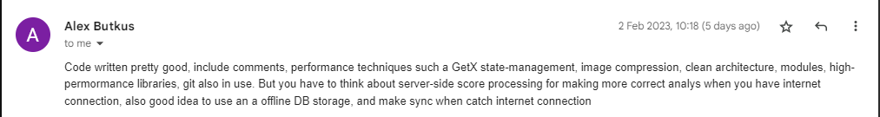
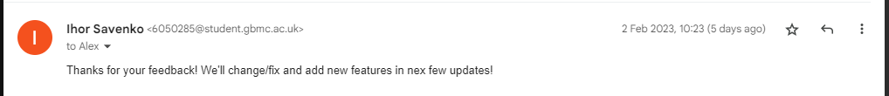
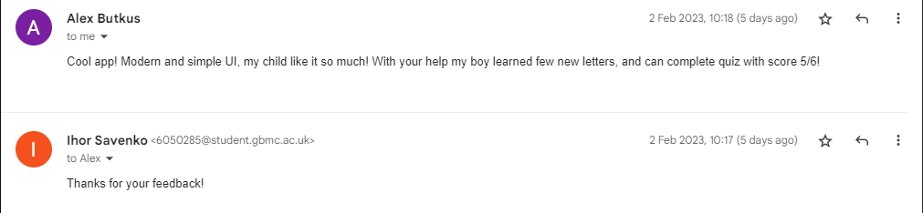
Feedbacks
Code Feedback:
App feedback:
Notes:
Before we start developing an application or a design for it - we need to research
and work out all the points of our application, and follow certain requirements for
the design of the application, since the target audience is children.
Since the application is for children, it should be intuitive,
because young children do not know much, and do not yet know
how to learn about something correctly.
Therefore, we will still expect that someone from parents, teachers, etc. will explain to the child how to use the application.
He can figure it out through hints and tutorial screens with tips when installing the app for the first time,
or use the scientific touch method, since the app will be minimalistic and intuitive,
and with features designed to make the app easier to use.
What user requirements are we counting on:
Cross-platform application(Android/IOS/PC WEB) – because many users have only iPhone, or any Android device, or only a PC, so we need make useful tool for all of these platforms.
Adaptive & simple design for all platforms – someone have a small phone, someone have big tablet or big screen of PC so design must be adaptive.
Simple app navigation via buttons, swipes, taps – we don’t need make nothing new, because mostly all users know about these gestures
The possibility of testing aka knowledge verification – After some in-app lessons users need check his
Demonstration of the material in the form of something to make it easier to understand a letter, a word. For example, most alphabets for children have some animals or objects from everyday life that the child already knows, and you can easily guess where this letter is used
Offline mode – people don’t have internet connection or good internet everywhere and every time so offline mode is a good solution
Game mode – kids can pay attention by light colours, sounds and while something in move
Pronunciation learning and practice
Intended purpose - to give users (mainly children) the opportunity to learn the alphabet of a certain language (it can be both their native language and some other), using simple methods, possibly in a game way, and the opportunity to test their knowledge in alphabet just like what EduTek wants.
But accessibility is a chunk confined to those who are absolutely blind due to the fact you can’t convert a number of the content material at the screen, such as visible photos into speech or braille. It can be properly for those who are partly sighted for the reason that app placed the colours in properly use.

Slide 14
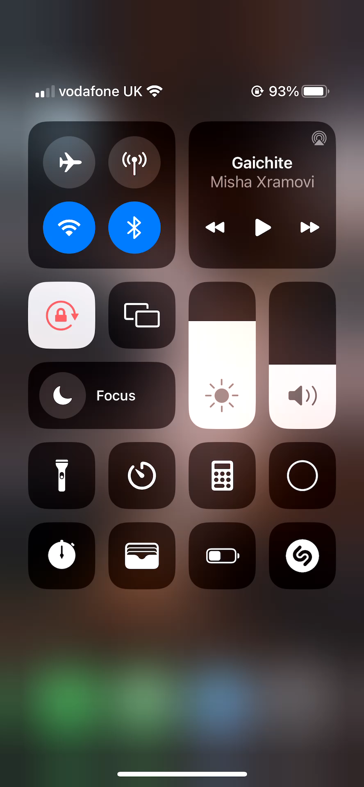
Video Demonstration
https://drive.google.com/file/d/18cHdRMt2OwdcCaUzxxhkOvG3bxhJ6lc7/view
Notes:
Before we start developing an application or a design for it - we need to research
and work out all the points of our application, and follow certain requirements for
the design of the application, since the target audience is children.
Since the application is for children, it should be intuitive,
because young children do not know much, and do not yet know
how to learn about something correctly.
Therefore, we will still expect that someone from parents, teachers, etc. will explain to the child how to use the application.
He can figure it out through hints and tutorial screens with tips when installing the app for the first time,
or use the scientific touch method, since the app will be minimalistic and intuitive,
and with features designed to make the app easier to use.
What user requirements are we counting on:
Cross-platform application(Android/IOS/PC WEB) – because many users have only iPhone, or any Android device, or only a PC, so we need make useful tool for all of these platforms.
Adaptive & simple design for all platforms – someone have a small phone, someone have big tablet or big screen of PC so design must be adaptive.
Simple app navigation via buttons, swipes, taps – we don’t need make nothing new, because mostly all users know about these gestures
The possibility of testing aka knowledge verification – After some in-app lessons users need check his
Demonstration of the material in the form of something to make it easier to understand a letter, a word. For example, most alphabets for children have some animals or objects from everyday life that the child already knows, and you can easily guess where this letter is used
Offline mode – people don’t have internet connection or good internet everywhere and every time so offline mode is a good solution
Game mode – kids can pay attention by light colours, sounds and while something in move
Pronunciation learning and practice
Intended purpose - to give users (mainly children) the opportunity to learn the alphabet of a certain language (it can be both their native language and some other), using simple methods, possibly in a game way, and the opportunity to test their knowledge in alphabet just like what EduTek wants.
But accessibility is a chunk confined to those who are absolutely blind due to the fact you can’t convert a number of the content material at the screen, such as visible photos into speech or braille. It can be properly for those who are partly sighted for the reason that app placed the colours in properly use.

Slide 15
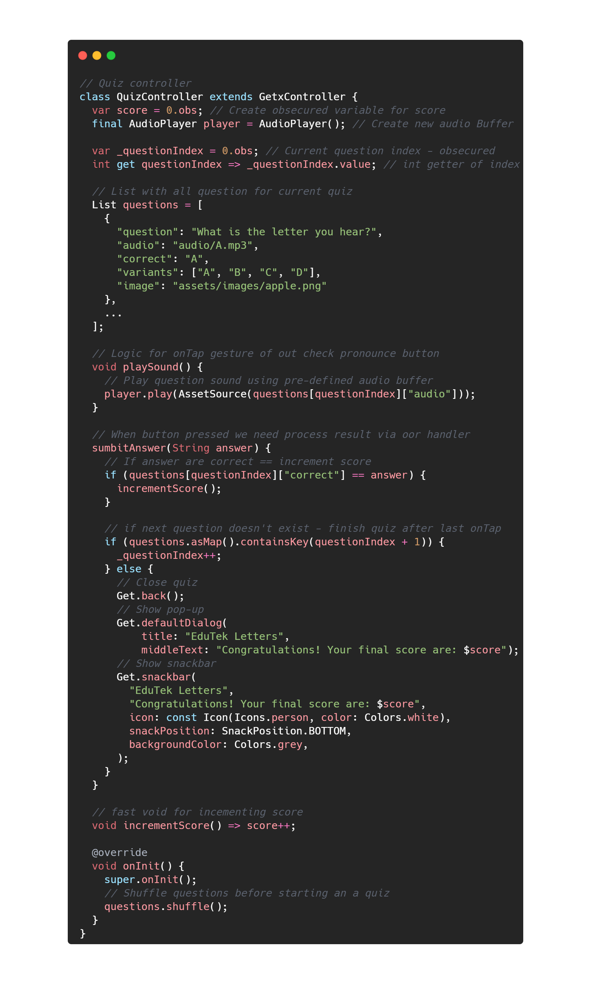
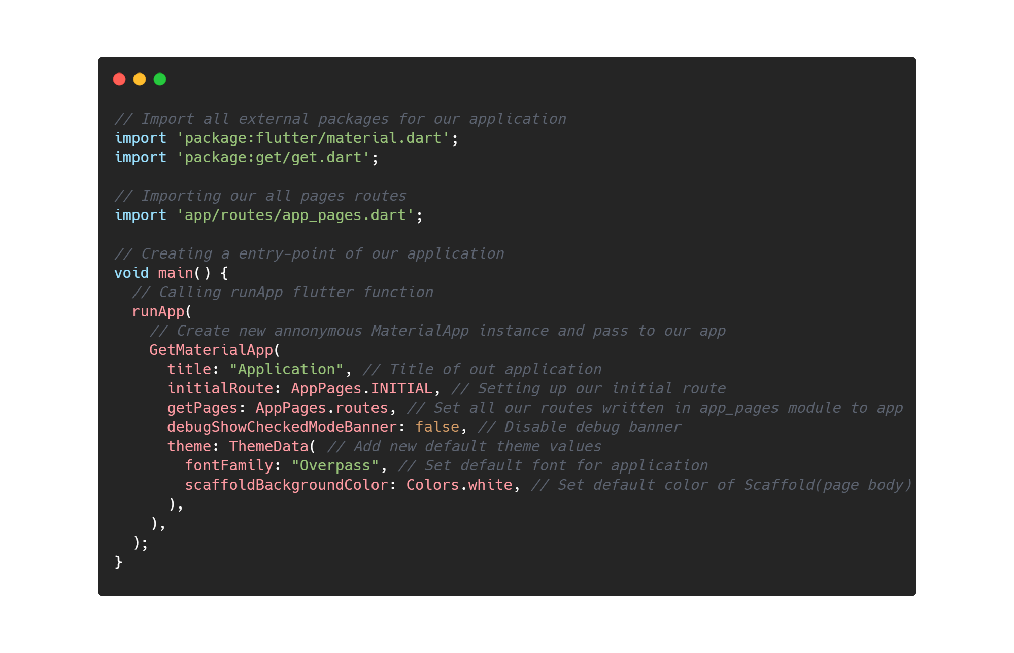
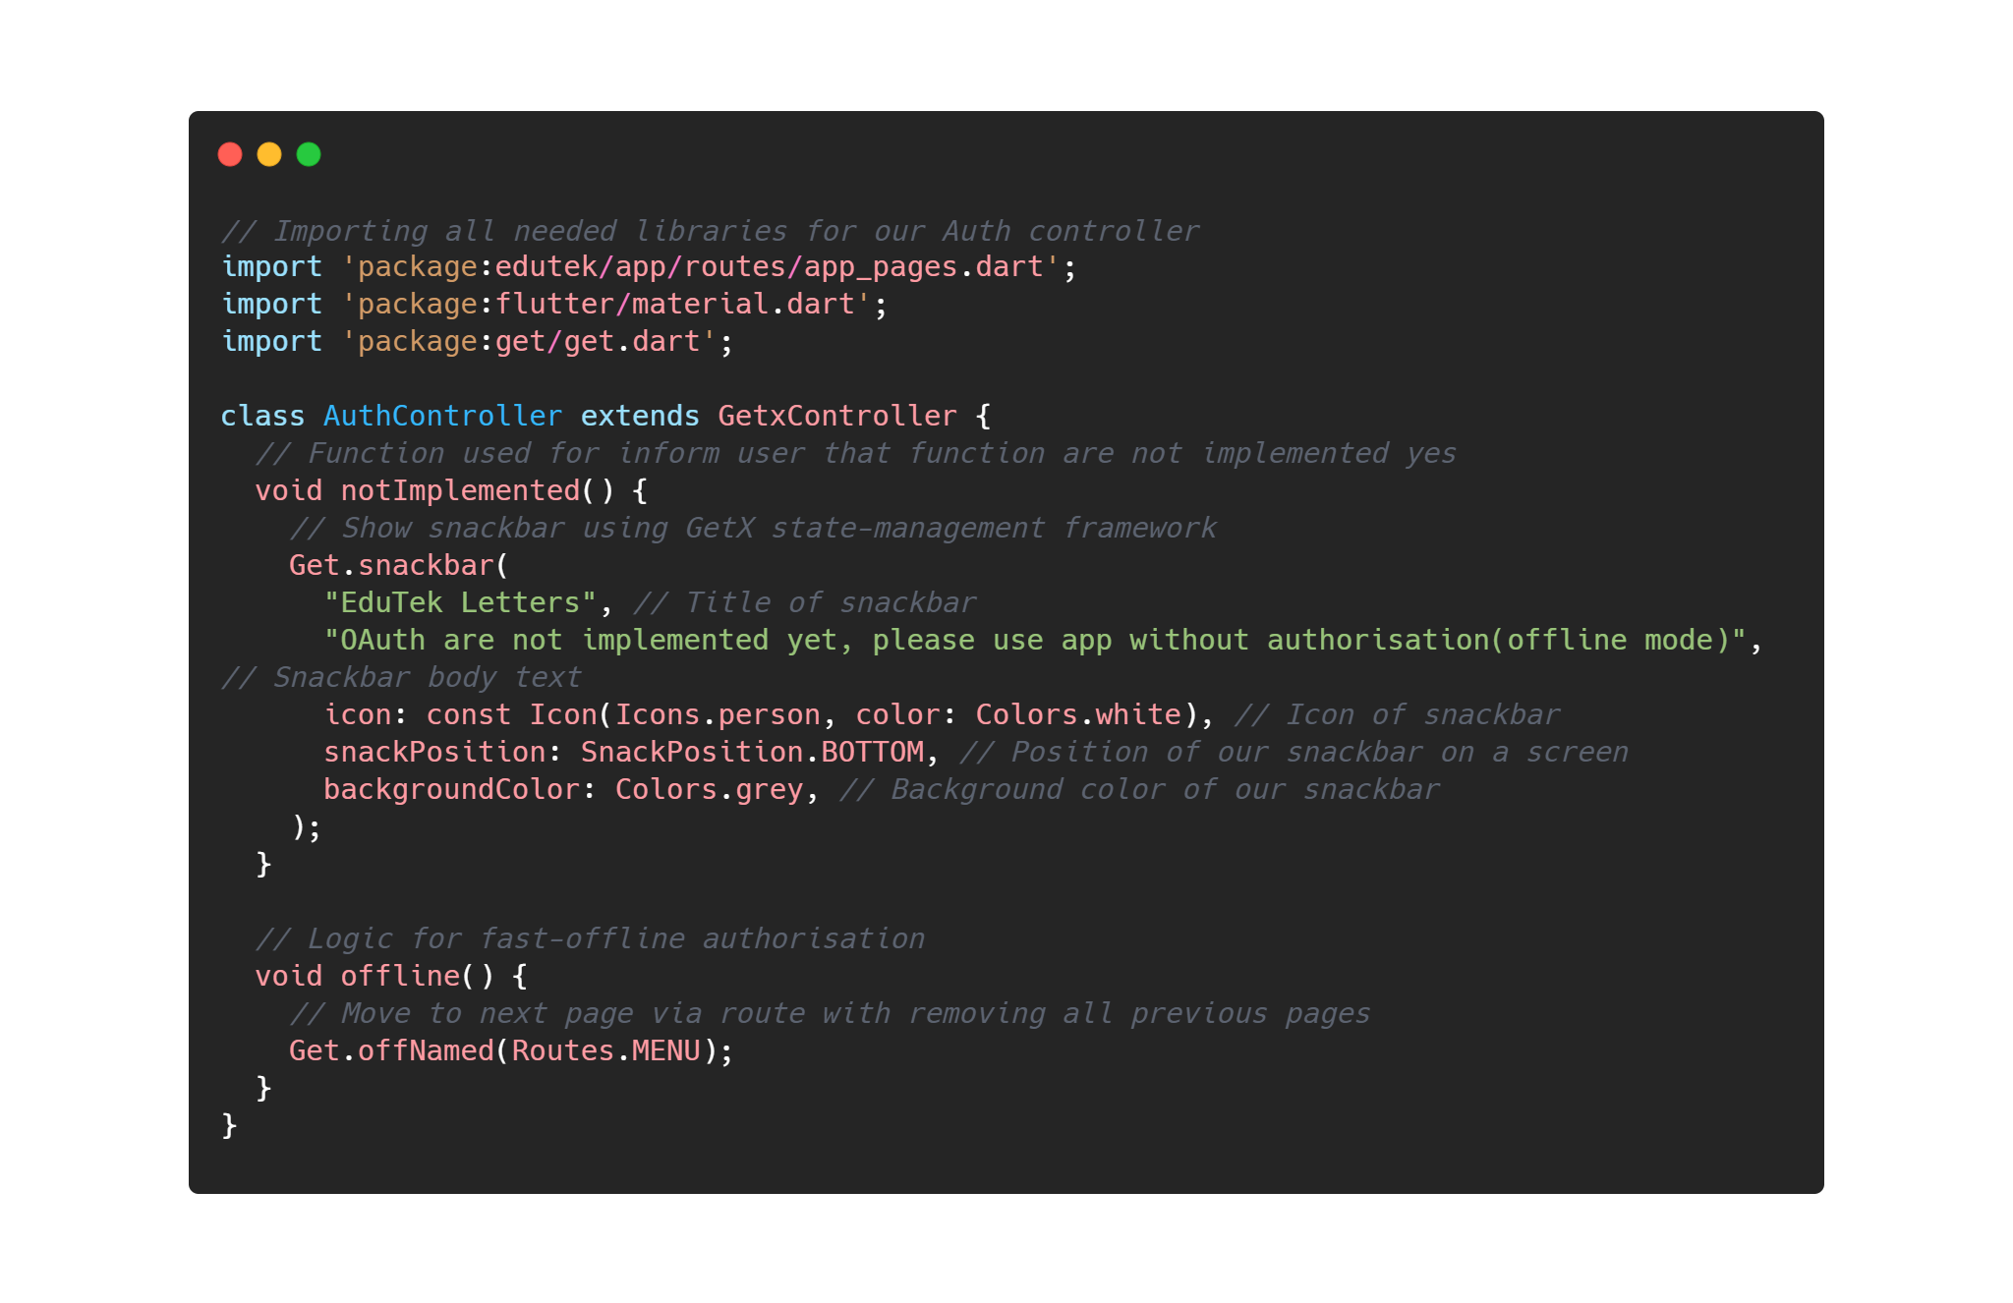
Source Code
main.dart File with App entry-point code
AuthContoller – logic for authorisation screen
Quiz logic controller
GitHub link – https://github.com/denver-code/EduTekLetters
Notes:
Before we start developing an application or a design for it - we need to research
and work out all the points of our application, and follow certain requirements for
the design of the application, since the target audience is children.
Since the application is for children, it should be intuitive,
because young children do not know much, and do not yet know
how to learn about something correctly.
Therefore, we will still expect that someone from parents, teachers, etc. will explain to the child how to use the application.
He can figure it out through hints and tutorial screens with tips when installing the app for the first time,
or use the scientific touch method, since the app will be minimalistic and intuitive,
and with features designed to make the app easier to use.
What user requirements are we counting on:
Cross-platform application(Android/IOS/PC WEB) – because many users have only iPhone, or any Android device, or only a PC, so we need make useful tool for all of these platforms.
Adaptive & simple design for all platforms – someone have a small phone, someone have big tablet or big screen of PC so design must be adaptive.
Simple app navigation via buttons, swipes, taps – we don’t need make nothing new, because mostly all users know about these gestures
The possibility of testing aka knowledge verification – After some in-app lessons users need check his
Demonstration of the material in the form of something to make it easier to understand a letter, a word. For example, most alphabets for children have some animals or objects from everyday life that the child already knows, and you can easily guess where this letter is used
Offline mode – people don’t have internet connection or good internet everywhere and every time so offline mode is a good solution
Game mode – kids can pay attention by light colours, sounds and while something in move
Pronunciation learning and practice
Intended purpose - to give users (mainly children) the opportunity to learn the alphabet of a certain language (it can be both their native language and some other), using simple methods, possibly in a game way, and the opportunity to test their knowledge in alphabet just like what EduTek wants.
But accessibility is a chunk confined to those who are absolutely blind due to the fact you can’t convert a number of the content material at the screen, such as visible photos into speech or braille. It can be properly for those who are partly sighted for the reason that app placed the colours in properly use.

Slide 16
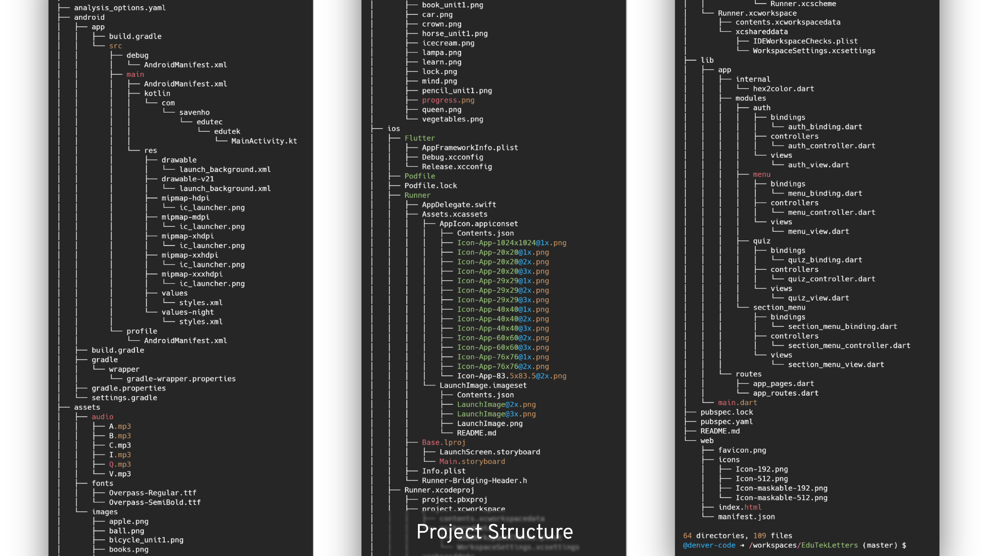
Notes:
Before we start developing an application or a design for it - we need to research
and work out all the points of our application, and follow certain requirements for
the design of the application, since the target audience is children.
Since the application is for children, it should be intuitive,
because young children do not know much, and do not yet know
how to learn about something correctly.
Therefore, we will still expect that someone from parents, teachers, etc. will explain to the child how to use the application.
He can figure it out through hints and tutorial screens with tips when installing the app for the first time,
or use the scientific touch method, since the app will be minimalistic and intuitive,
and with features designed to make the app easier to use.
What user requirements are we counting on:
Cross-platform application(Android/IOS/PC WEB) – because many users have only iPhone, or any Android device, or only a PC, so we need make useful tool for all of these platforms.
Adaptive & simple design for all platforms – someone have a small phone, someone have big tablet or big screen of PC so design must be adaptive.
Simple app navigation via buttons, swipes, taps – we don’t need make nothing new, because mostly all users know about these gestures
The possibility of testing aka knowledge verification – After some in-app lessons users need check his
Demonstration of the material in the form of something to make it easier to understand a letter, a word. For example, most alphabets for children have some animals or objects from everyday life that the child already knows, and you can easily guess where this letter is used
Offline mode – people don’t have internet connection or good internet everywhere and every time so offline mode is a good solution
Game mode – kids can pay attention by light colours, sounds and while something in move
Pronunciation learning and practice
Intended purpose - to give users (mainly children) the opportunity to learn the alphabet of a certain language (it can be both their native language and some other), using simple methods, possibly in a game way, and the opportunity to test their knowledge in alphabet just like what EduTek wants.
But accessibility is a chunk confined to those who are absolutely blind due to the fact you can’t convert a number of the content material at the screen, such as visible photos into speech or braille. It can be properly for those who are partly sighted for the reason that app placed the colours in properly use.

